Slide 1


DATA 400, MINI PROJECT
BY DARCELY PEÑA
PREDICTING RENT PRICES IN THE BRONX, NY

Slide 2
01. Research Question
02. Data Retrival
03. Exploratory Data Analysis
TABLE OF CONTENTS
04. Models
05. Implications for Stakeholders
06. Ethical Implications

Slide 3
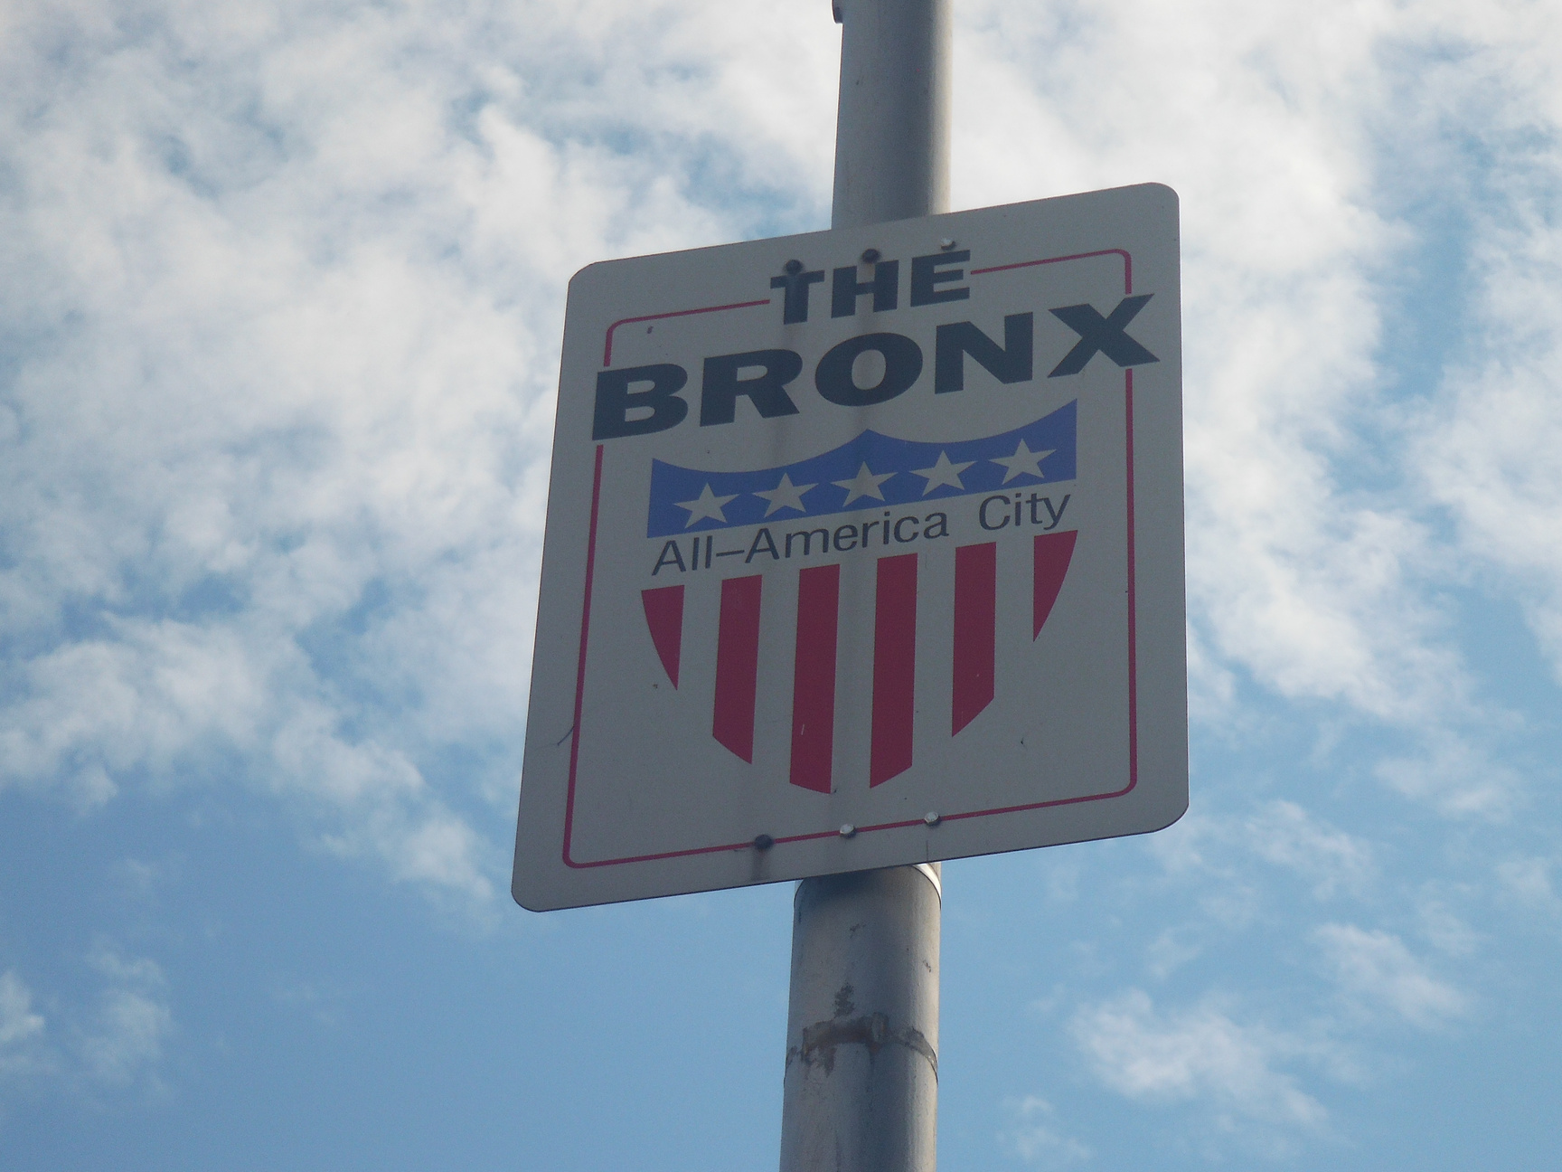
RESEARCH QUESTION
RESEARCH QUESTION
Which demographic, social, and economic factors strongly predict gross rent prices in the Bronx, New York?
POSSIBLE FACTORS
Race & Ethnicity, Age, Gender, Household Income, Unemployment Rates
GOALS
Determine which ZIP codes in the Bronx have the highest gross rent prices and the fastest rent growth
Identifies key predictors of gross rent prices
Forecasts gross rent prices in the upcoming year

Slide 4
DATA RETRIVAL
U.S. Census American Community Survey
Source: U.S. Census Bureau, American Community Survey (ACS)
Datasets Used:
Demographic and Housing Estimates
Economic Characteristics
Median Gross Rent Prices by # of Bedrooms
Timeframe: 2016–2023
Scope: 25 ZIP codes in the Bronx, NY
Final Dataset: 200 rows, 40 columns
Methodology
Download the dataset for each year (8) for each survey (3)
Reformat each dataset so that it can be imported
Concatenate yearly datasets for each survey
Merge all 3 survey datasets into a final dataset using inner join on zip code and year
Custom columns: calculated racial & ethnic group percentages and unemployment rate

Slide 5
VARIABLES
Zip Code
Total population
Male
Female
Median age (years)
One race
White
Black or African American
American Indian and Alaska Native
Asian
Native Hawaiian and Other Pacific Islander
Some Other Race
Two or More Races
Hispanic or Latino (of any race)
Year
Population 16 years and over
In labor force
Employed
Unemployed
Total households
Median household income (dollars)
Mean household income (dollars)
With cash public assistance income
With Food Stamp/SNAP benefits in the past 12 months
Total
No bedroom
1 bedroom
2 bedrooms
3 bedrooms
4 bedrooms
5 or more bedrooms
White_percentage
Black or African American_percentage
American Indian and Alaska Native_percentage
Asian_percentage
Native Hawaiian and Other Pacific Islander_percentage
Some Other Race_percentage
Two or More Races_percentage
Hispanic or Latino (of any race)_percentage
Unemployment Rate

Slide 6
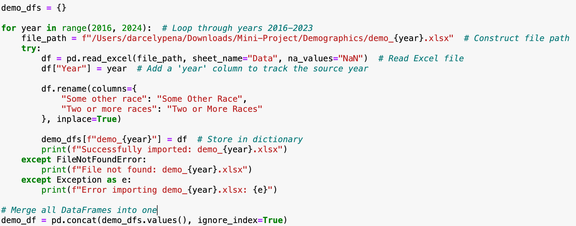
CONCATENATING YEARLY DATASETS

Slide 7
MERGING EACH SURVEY

Slide 8
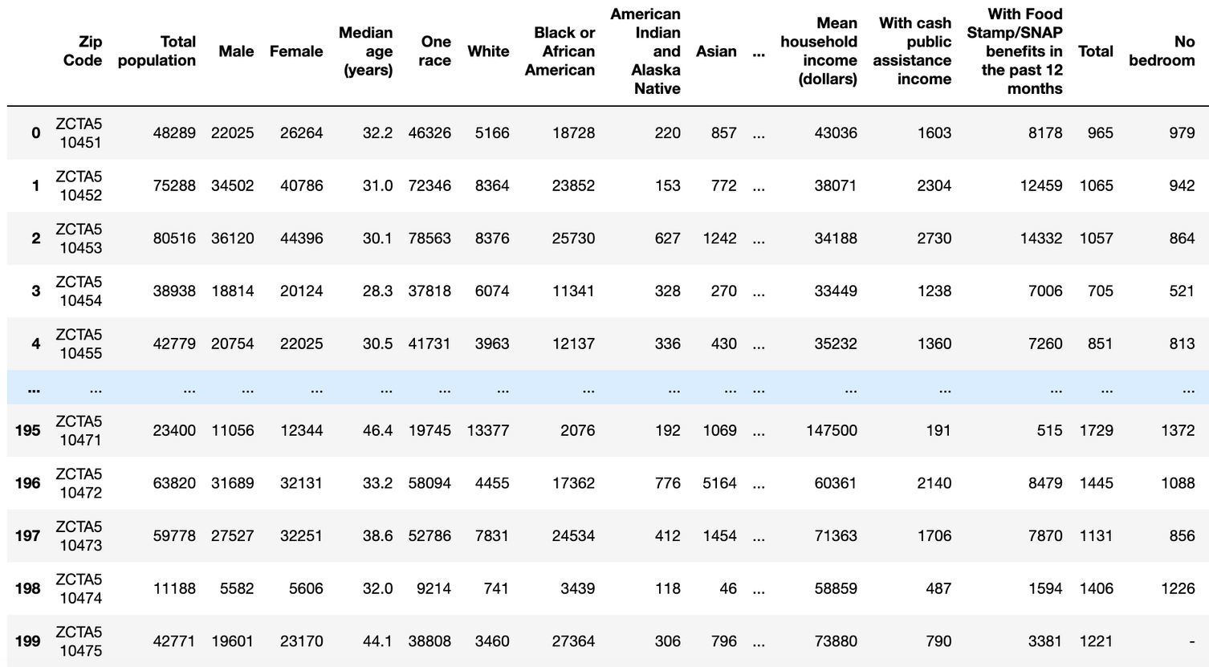
FINAL DATASET

Slide 9
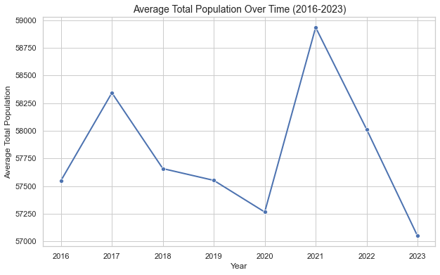
TRENDS OVER TIME

Slide 10
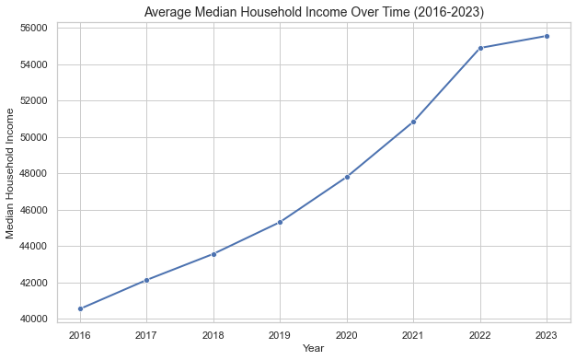
TRENDS OVER TIME

Slide 11
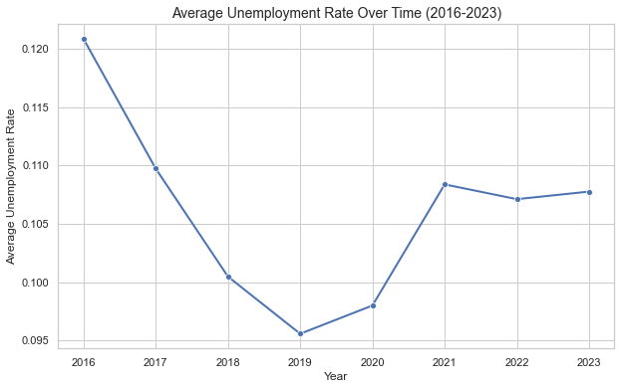
TRENDS OVER TIME

Slide 12
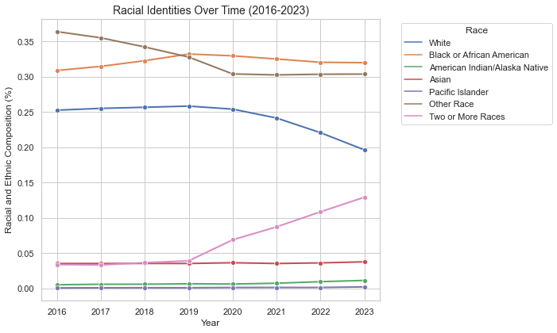
TRENDS OVER TIME

Slide 13
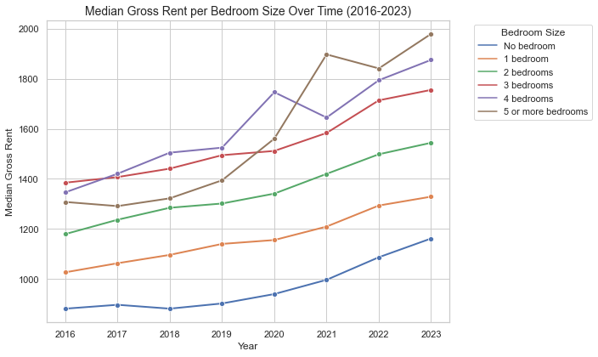
TRENDS OVER TIME

Slide 14
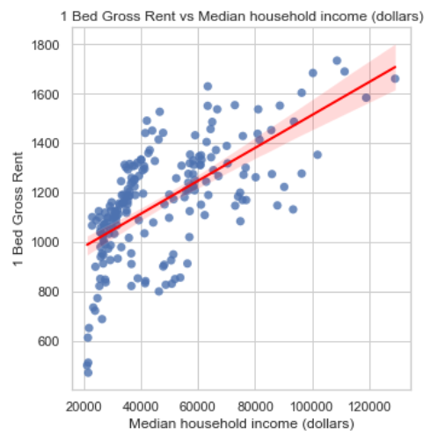
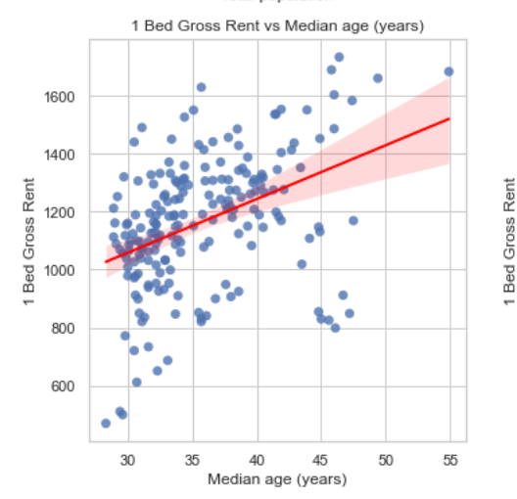
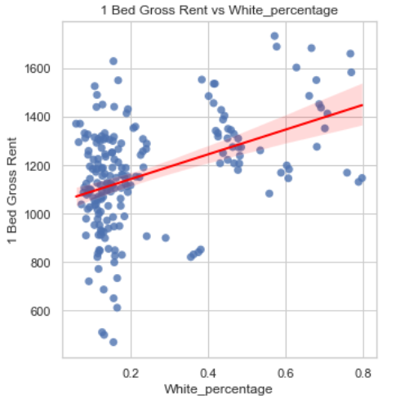
SCATTER PLOTS
1 Bedroom Gross Rent vs Possible Predictors:

Slide 15
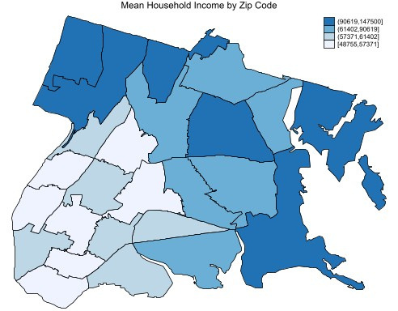
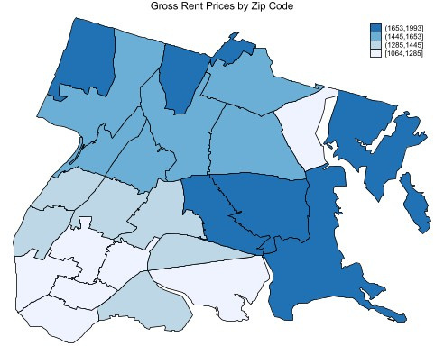
MOST RECENT YEAR (2023)
Three Highest Zip Codes: Riverdale & Fieldston (10471), City Island (10464), Throggs Neck, Country Club, and Edgewater Park (10465 )
Three HIghest Zip Codes: City Island (10464), Throggs Neck, Country Club, and Edgewater Park (10465 ), Pelham Gardens, Baychester, Bronx Park (10461)
Three Lowest Zip Codes: Melrose (10456), Longwood, Mott Haven, and Morrisania (10455), Morris Heights (10453)
Three Lowest Zip Codes: Mott Haven (10454), Longwood, Mott Haven, and Morrisania neighborhoods (10455), Soundview and Clason Point (10473)

Slide 16
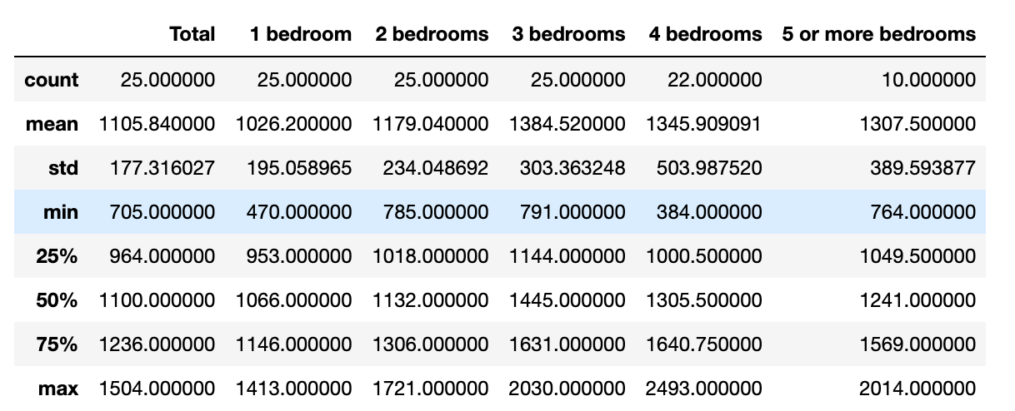
MOST RECENT YEAR
Summary statistics for gross rent prices by bedroom in 2023:

Slide 17

IMPLICATIONS
Bronx residents can make informed decisions about whether they can afford to continue living in their area or if they should consider relocating to more affordable neighborhoods.
Policymakers can better understand the extent of gentrification and develop strategies to keep housing affordable for long-time residents, preventing displacement.
Urban planners, housing advocates, and community organizations can leverage this data to push for equitable housing policies and sustainable development that prioritizes affordability and inclusivity.

Slide 18
THANK YOU! QUESTIONS?

